Slide 1
CSC 323 – Principles of Operating Systems
Instructor: Ms. Mamoona Tasadduq
Lecture# 02: Operating System Structure and Services

Slide 2
Typical Operating System Structure
Written by programmer
Compiled by programmer
Uses library calls
Written by gurus
Provided pre-compiled
Interface defined in headers
Invoked like functions
Input to linker (compiler)
Maybe “resolved” when program is loaded
Applications
Libraries
User level
Kernel level
Machine-Dependent Layer
Portable OS Layer
Bootstrap
System Initialization
I/O device driver
Kernel/user mode switching
Interrupt and exception
Process management
“Guts” of system calls
All “high-level” code

Slide 3
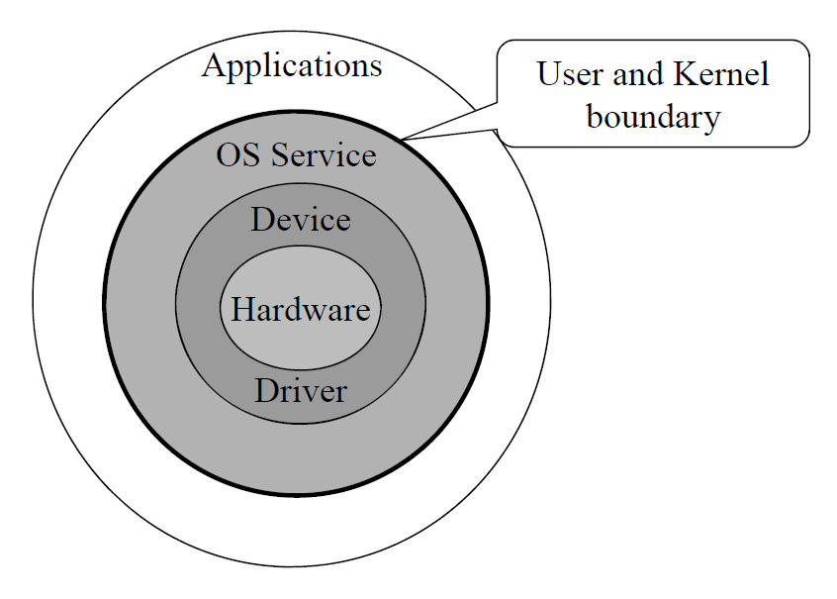
Typical Operating System Structure
Another Look: Unix “Onion”

Slide 4
Operating System Kernel
A kernel is a central component of an operating system and is the one program always running. It acts as an interface between the user applications and the hardware. Everything else is either a system program or an application program.
The main tasks of the kernel include process management, device management, memory management, interrupt handling, I/O communication and file system management.
Classified mainly into two categories
  Monolithic (Mono means single, Lithic means layer)
  Micro Kernel

Slide 5
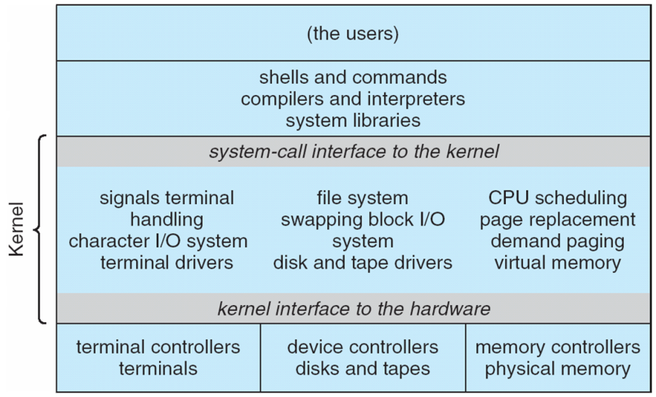
Monolithic Kernel
An old approach where basic system services like process and memory management, interrupt handling etc. were packed into a single module in kernel space.
Some serious problems like
  Huge size,
  Poor maintainability (bug fixing and addition of new features results in recompilation of the whole kernel code which could consume hours)
  E.g., MS-DOS

Slide 6
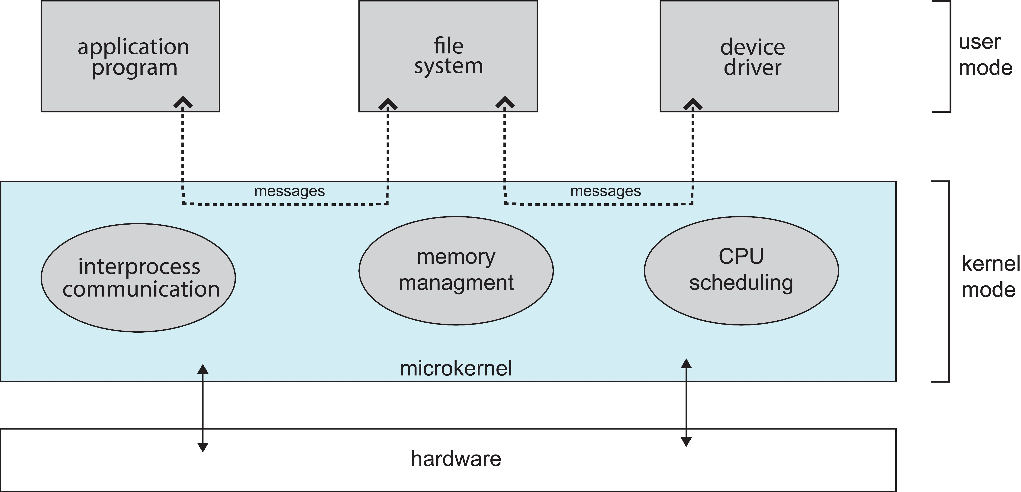
Micro Kernel
Modular Approach: Moves as much from the kernel into the user space
Easily maintainable as different modules can be dynamically loaded/un-loaded.
Communication takes place between user modules using message passing
Easier to extend a microkernel and port the OS to new architectures
More reliable and secure due to reduced kernel size. e.g., if network service crashes due to buffer overflow, then only the networking services memory would be corrupted, leaving the rest of the system still functional.
Performance overhead of user space to kernel space communication
This architecture allows some basic services to run in user space
  E.g., device driver management, protocol stack, file system etc.

Slide 7
Operating System Services
Process Management
Memory Management
File-system Management
Mass-Storage Management
Protection and Security
I/O System Management
Networking (Distributed Systems)
Command-interpreter System

Slide 8
Process Management
A process is a program in execution. It is a unit of work within the system. Program is a passive entity; process is an active entity.
Process needs resources to accomplish its task e.g., CPU, memory, I/O, files
Process termination requires reclaim of any reusable resources
Process executes instructions sequentially, one at a time, until completion. Program counter of a process specifies location of next instruction to execute
Typically, a system has many processes, some users, some operating system running concurrently on one or more CPUs
In connection with process management, operating system activities include:
  Creating, deleting, suspending, and resuming of both user and system processes
  Provide mechanisms for process communication and process synchronization
  Providing mechanisms for deadlock handling

Slide 9
Memory Management
To execute a program all (or part) of its instructions must be in memory
Memory management determines what is in memory and when
  Optimizing CPU utilization and computer response to users
In connection with memory management, operating system activities include:
  Allocating and deallocating memory space as needed
  Keeping track of which parts of memory are currently being used and by whom
  Deciding which processes (or parts thereof) and data to move into and out of memory
  Support larger address space than physical memory

Slide 10
File-system Management
OS provides uniform, logical view of information storage
  Abstracts physical properties to logical storage unit - file
  Each medium is controlled by device (i.e., disk drive, tape drive)
    Varying properties include access speed, capacity, data-transfer rate, access method (sequential or random)
Files usually organized into directories
Access control on most systems to determine who can access what
In connection with file-system management, operating system activities include:
  Creating, deleting, reading and writing files and directories
  Primitives to search and manipulate files and directories
  Mapping files onto secondary storage
  Backup files onto stable (non-volatile) storage media
  File Sharing and protection

Slide 11
Mass-Storage Management
Usually, disks used to store data that does not fit in main memory or data that must be kept for a “long” period
Proper management is of central importance
Entire speed of computer operation hinges on disk subsystem and its algorithms
In connection with mass-storage management, OS activities include:
  Mounting and unmounting
  Free-space management
  Storage allocation
  Disk scheduling
  Partitioning
  Protection

Slide 12
Protection and Security
Protection – any mechanism for controlling access of processes or users to resources defined by the OS
Security – defense of the system against internal and external attacks
  Huge range, including denial-of-service, worms, viruses, identity theft, theft of service
Systems generally first distinguish among users, to determine who can do what
  User identities (user IDs, security IDs) include name and associated number, one per user
  User ID then associated with all files, processes of that user to determine access control
  Group identifier (group ID) allows set of users to be defined and controls managed, then also associated with each process, file
  Privilege escalation allows user to change to effective ID with more rights

Slide 13
I/O System Management
I/O devices of many flavors
  Storage devices: drives, tapes
  Transmission devices: NIC, modems
  Human-interface devices: screen, keyboard, mouse
I/O subsystem hides peculiarities of I/O devices
I/O System consists of:
  A general device-driver interface (wrapper)
  Drivers for specific hardware devices
  Buffering/spooling/caching (access locality)

Slide 14
Networking (Distributed Systems)
A distributed system
  A collection of machines that do not share memory or a clock
  Provides user access to various system resources through a network
  Examples: WWW, banking, peer-to-peer, Internet, …
  Allows computation speed-up, increased data availability, enhanced reliability
The OS is responsible for
  Communication between processes
  Reliability – reliable protocols

Slide 15
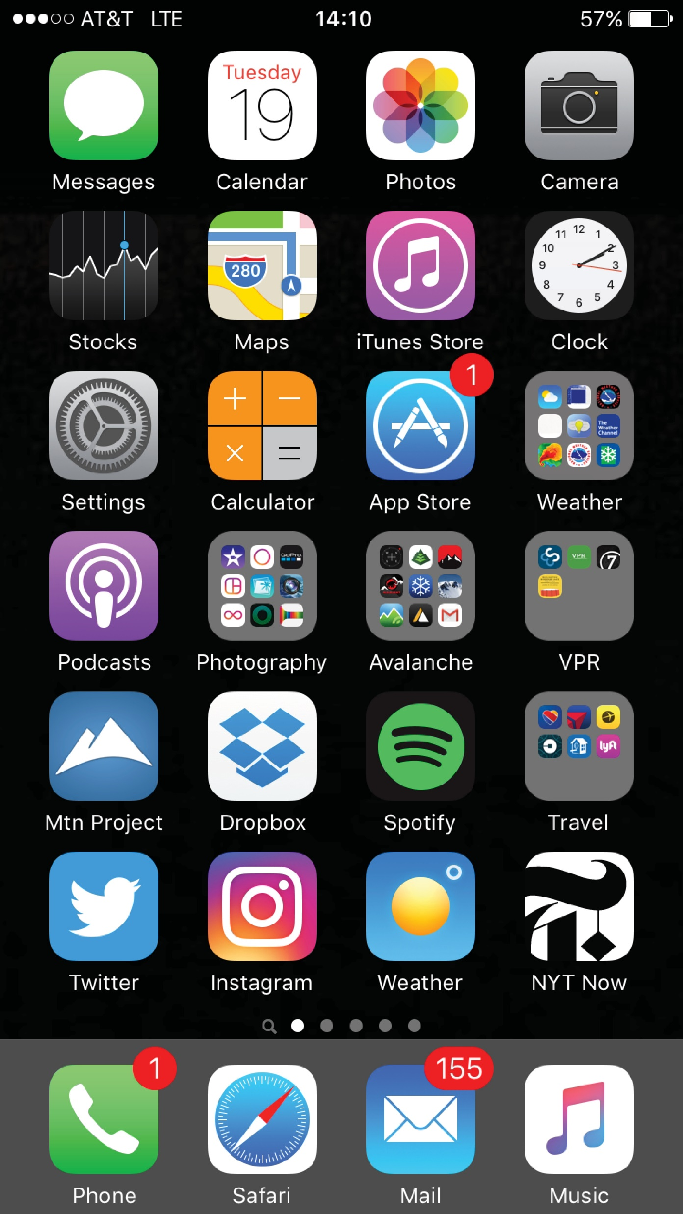
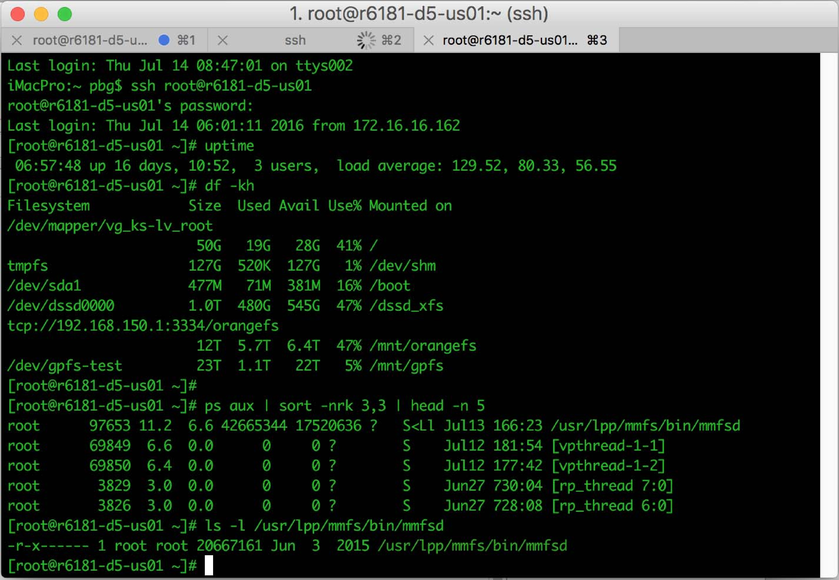
Command-Interpreter System
Command-Interpreter System: An interface between user and OS that primarily fetches a command from user and executes it
Many commands are given to the OS by control statements which deal with:
  Process creation and management (a.out, kill -9)
  Secondary-storage management (partition disk)
  File system: Access (ls, cat), protection (chmod 700 *, umask 077)
  Networking (telnet, ssh)
  Monitoring (ps, top, vmstat, netstat)
Wide range of different approaches to the interface
  Mouse-based windows-and-menus GUI (Mac, Windows)
  Command line (UNIX)
  Touchscreen (Mobile devices)
  Voice Commands

Slide 16
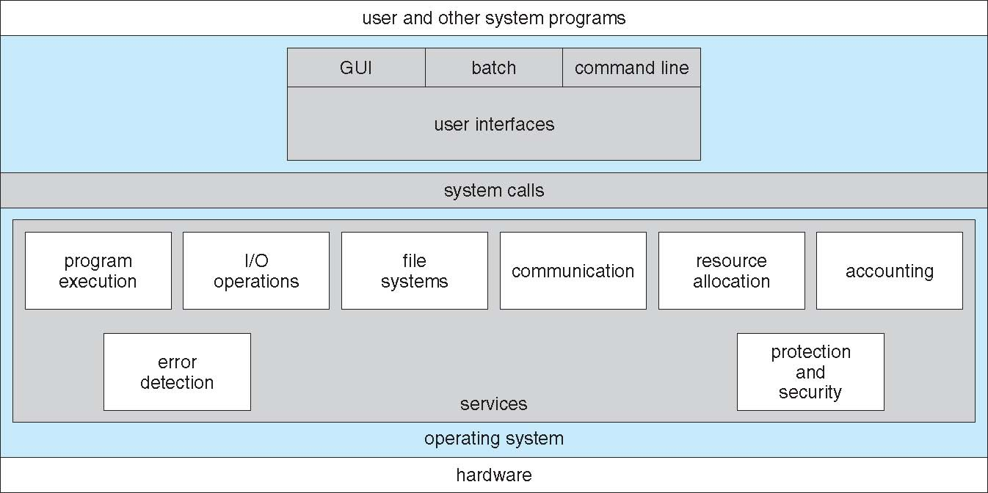
A View of Operating System Services

Slide 17
Operating System Debugging
Debugging is finding and fixing errors, or bugs
OS generate log files containing error information
Application failure generates core dump file capturing memory of the process
OS failure generates crash dump file containing kernel memory
Beyond crashes, performance tuning can optimize system performance
  Sometimes using trace listings of activities, recorded for analysis
  Profiling is periodic sampling of instruction pointer to look for statistical trends
Kernighan’s Law: “Debugging is twice as hard as writing the code in the first place. Therefore, if you write the code as cleverly as possible, you are, by definition, not smart enough to debug it.”

Slide 18
Performance Tuning and Tracing
Debugging interactions between user-level and kernel code nearly impossible without toolset that understands both and an instrument their actions
OS must provide means of computing and displaying measures of system behavior to improve performance by removing bottlenecks
  top
  Windows task manager
OS must provide means of collecting data for a specific event, such as steps involved in a system call invocation
  strace – trace system calls invoked by a process
  gdb – source-level debugger
  perf – collection of Linux performance tools
  tcpdump – collects network packets

Slide 19
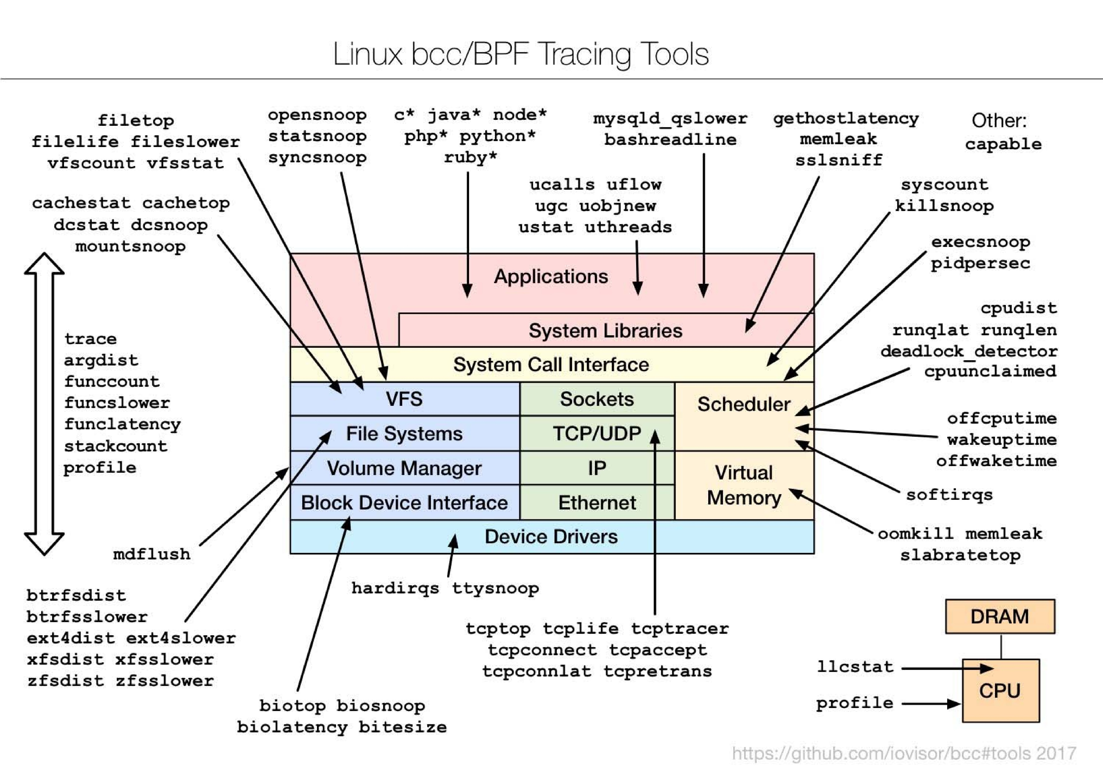
Linux bcc/BPF Tracing Tools

Slide 20
Why Start With Hardware?
OS functionality fundamentally depends upon architectural features
  Key goals of an OS are to enforce protection and resource sharing
  If done well, applications can be oblivious to hardware details
Architectural support can greatly simplify or complicate OS tasks
  Early DOS, MacOS lacked virtual memory in part because the HW did not support it
  Early Sun I computers used two M68000 CPUs to implement virtual memory

Slide 21
Architectural Features for OS
Features that directly support the OS include
  Bootstrapping
  Protection (kernel/user mode)
  Protected instructions
  Memory protection
  System calls
  Interrupts and exceptions
  Timer
  I/O control and operation
  Synchronization

Slide 22
Types of Architectural Support
Manipulating privileged machine state
  Protected instructions
  Manipulate device registers, TLB entries, etc.

Slide 23
Thought Experiment: A World of Anarchy
Any program in the system can
  Directly access I/O devices
  Write anywhere in the memory
  Read content from any memory address
  Execute machine halt instruction
Do you trust such system?
  Use Facebook app in this system
  Use Banking app in this system
Challenge: Protection
  How to execute a program with restricted privilege?

Slide 24
H/W Support: Dual-mode Operation in CPU
User-mode
  Limited privileges
  Only those granted by the operating system kernel
Kernel-mode
  Execution with full privileges of the hardware
  Read/write to any memory, access I/O device, read/write disk sector, send/read packet
Mode bit provided by hardware helps distinguish when system is running user code or kernel code.
  When user code is executing → mode bit is set to 1
  When kernel code is executing → mode bit is set to 0

Slide 25
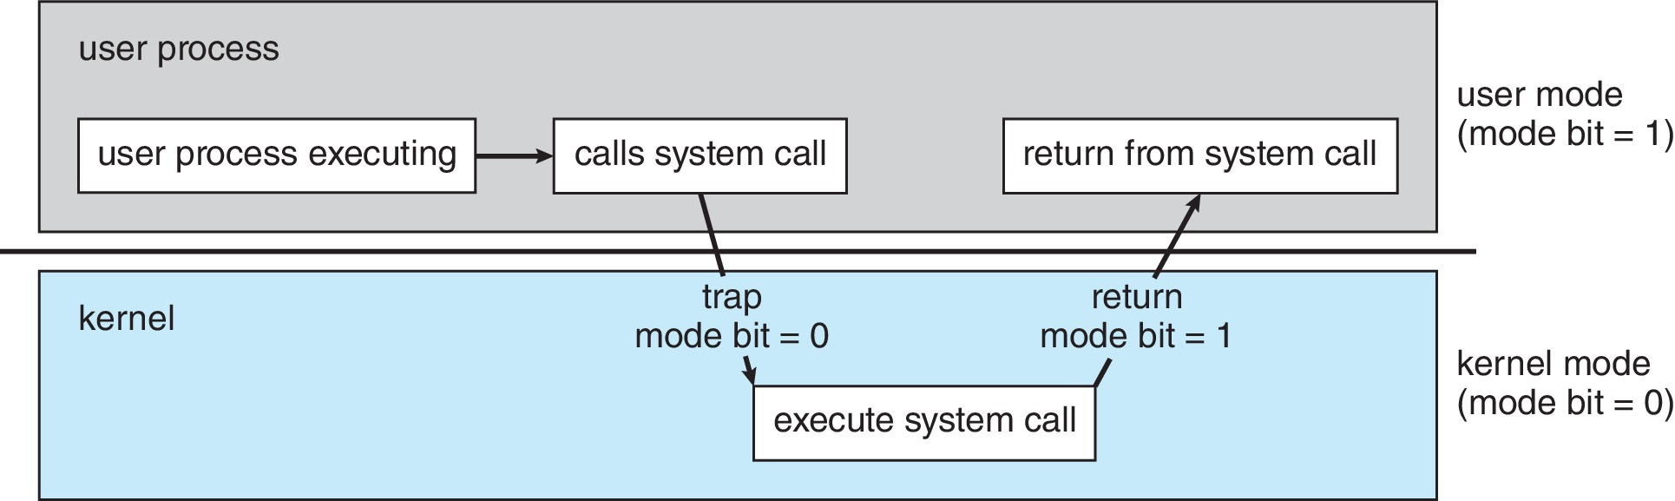
Transition from User to Kernel Mode
How does a user program request for accessing shared resources (e.g., HDD)?
How do we guarantee that user does not explicitly set the mode bit to “kernel”?
  System Calls

Slide 26
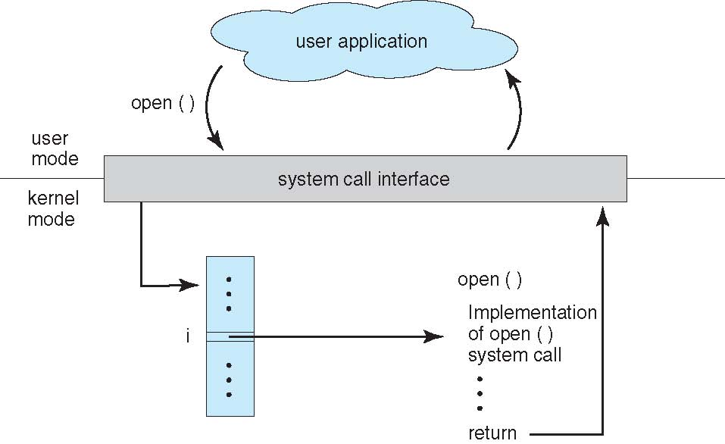
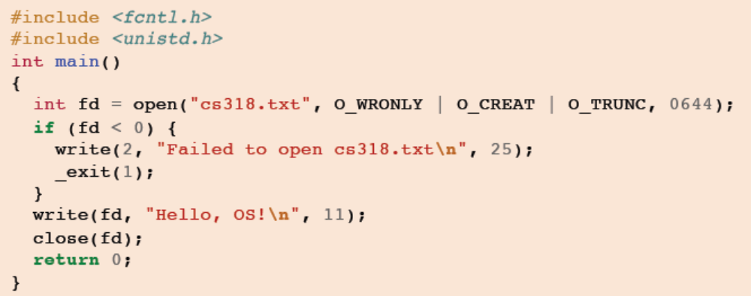
System Calls
Interface between a process and the OS kernel that can be written in high-level language like C or in assembly language
Applications can invoke kernel through system calls
  Special instructions transfers control to the kernel which dispatches to one of few hundred syscall handlers

Slide 27
System Calls
The only way for an application to invoke OS services
Goal: Do things applications cannot do in unprivileged mode
  Like a library call, but into more privileged kernel code
Kernel supplies well-defined system call interface
  Applications set up syscall arguments and trap to kernel
  Kernel performs operations and returns results
Sometimes, directly invoked in many languages (C or C++, Perl) via a high-level Application Programming Interface (API) rather than direct system call use.
  Win32, POSIX, Java

Slide 28
System Calls
#include <stdio.h>
int main() {
printf(“Hello OS!\n”);
return 0;
}
User mode
Kernel mode
standard C library
write()
write() system call implementation
Standard library calls are built on syscalls

Slide 29
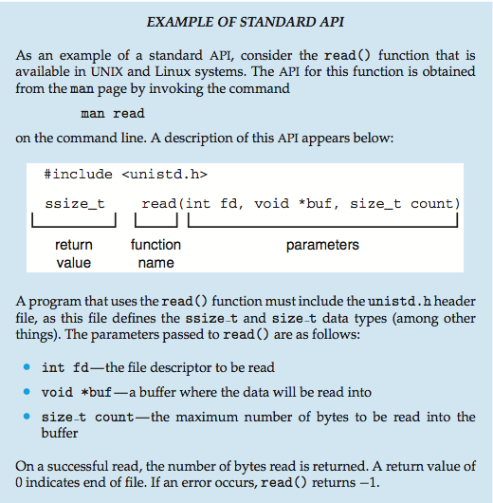
Standard API Example

Slide 30
System Call Implementation
Typically, a number associated with each system call
  System-call interface maintains a table indexed according to these numbers
The system call interface invokes intended system call in OS kernel and returns status of the system call and any return values
The caller need know nothing about how the system call is implemented
Just needs to obey API and understand what OS will do as a result call
Most details of OS interface hidden from programmer by API
  Managed by run-time support library (set of functions built into libraries included with compiler)

Slide 31
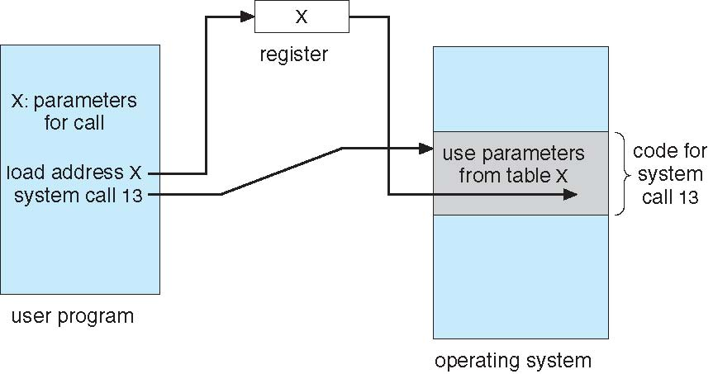
System Call Parameter Passing
Some system calls require additional information that is passed as parameters
Three general methods used to pass parameters to the OS
  Simplest: pass the parameters in registers
    In some cases, may be more parameters than registers
  Parameters stored in a block, or table, in memory, and address of block passed as a parameter in a register (Linux and Solaris)
  Parameters pushed onto the stack by the program and popped off the stack by the operating system
Block and stack methods do not limit the number or length of parameters being passed

Slide 32
System Calls
Categories
  Process Management: end, abort, load, execute, create process, terminate process, get process attributes, set process attributes, wait for time, wait event, signal event, allocate and free memory, dump memory if error, debugger for determining bugs, single step execution, locks for managing access to shared data between processes.
  File Management: create file, delete file, open file, close file, read, write, reposition, get and set file attributes.
  Device Management: request device, release device, read, write, reposition, get device attributes, set device attributes, logically attach or detach devices
  Protection: Control access to resources, get and set permissions, allow and deny user access
  Information Maintenance: get time or date, set time or date, get system data, set system data, get and set process, file, or device attributes
  Communications: create, delete communication connection, send, receive messages, create and gain access to memory regions, transfer status information, attach and detach remote devices

Slide 33
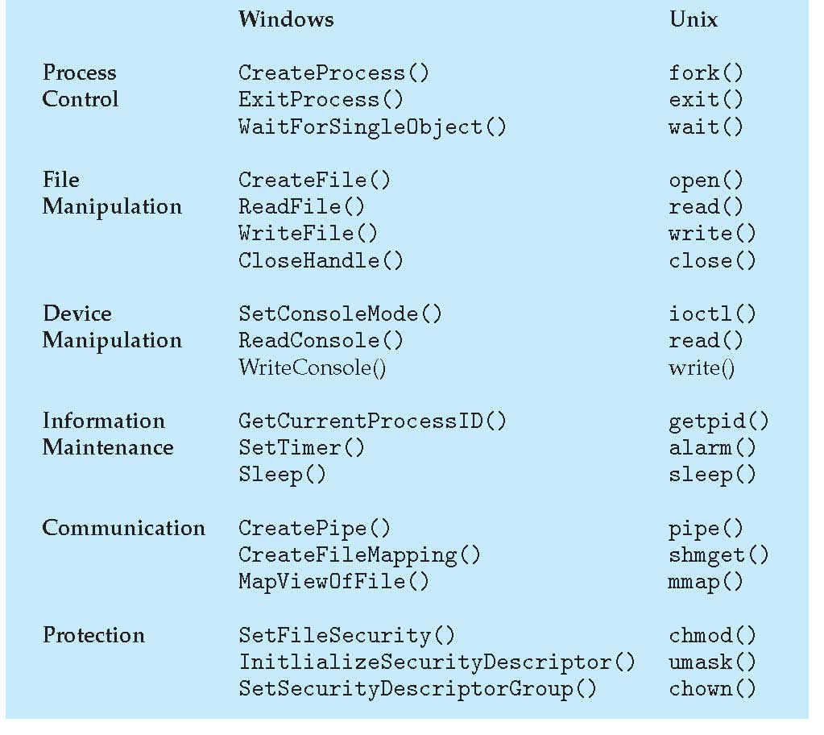
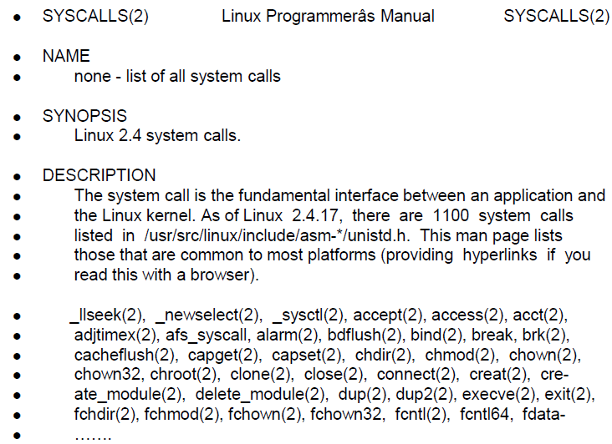
System Calls

Slide 34
System Services
System programs provide a convenient environment for program development and execution. They can be divided into:
  File Manipulation
  Status information sometimes stored in a file
  Programming language support
  Program loading and execution
  Communications
  Background services
  Application programs
Most users’ view of the operating system is defined by system programs, not the actual system calls

Slide 35
System Services
File Manipulation
  Text editors to create and modify files
  Special commands to search contents of files or perform transformations of the text
Status Information
  Some ask the system for info - date, time, amount of available memory, disk space, number of users
  Others provide detailed performance, logging, and debugging information
  Typically, these programs format and print the output to the terminal or other output devices
  Some systems implement a registry – used to store and retrieve configuration information

Slide 36
System Services
Programming-language support – Compilers, assemblers, debuggers and interpreters sometimes provided
Program loading and execution – Absolute loaders, relocatable loaders, linkage editors, and overlay-loaders, debugging systems for higher-level and machine language
Communications – Provide the mechanism for creating virtual connections among processes, users, and computer systems
  Allow users to send messages to one another’s screens, browse web pages, send electronic-mail messages, log in remotely, transfer files from one machine to another

Slide 37
System Services
Background Services
  Launch at boot time
    Some for system-startup, then terminate
    Some from system boot to shutdown
  Provide facilities like disk checking, process scheduling, error logging, printing
  Run in user context not kernel context
  Known as services, subsystems, daemons
Application Programs
  Don’t pertain to system
  Run by users
  Not typically considered part of OS
  Launched by command line, mouse click, finger poke

Slide 38
Linkers and Loaders
Source code compiled into object files designed to be loaded into any physical memory location – relocatable object file
Linker combines these into single binary executable file (also brings in libraries)
Program resides on secondary storage as binary executable and must be brought into memory by loader to be executed
  Relocation assigns final addresses to program parts and adjusts code and data in program to match those addresses
Modern general-purpose systems don’t link libraries into executables. Rather, dynamically linked libraries (in Windows, DLLs) are loaded as needed, shared by all that use the same version of that same library (loaded once)
Object, executable files have standard formats, so operating system knows how to load and start them

Slide 39
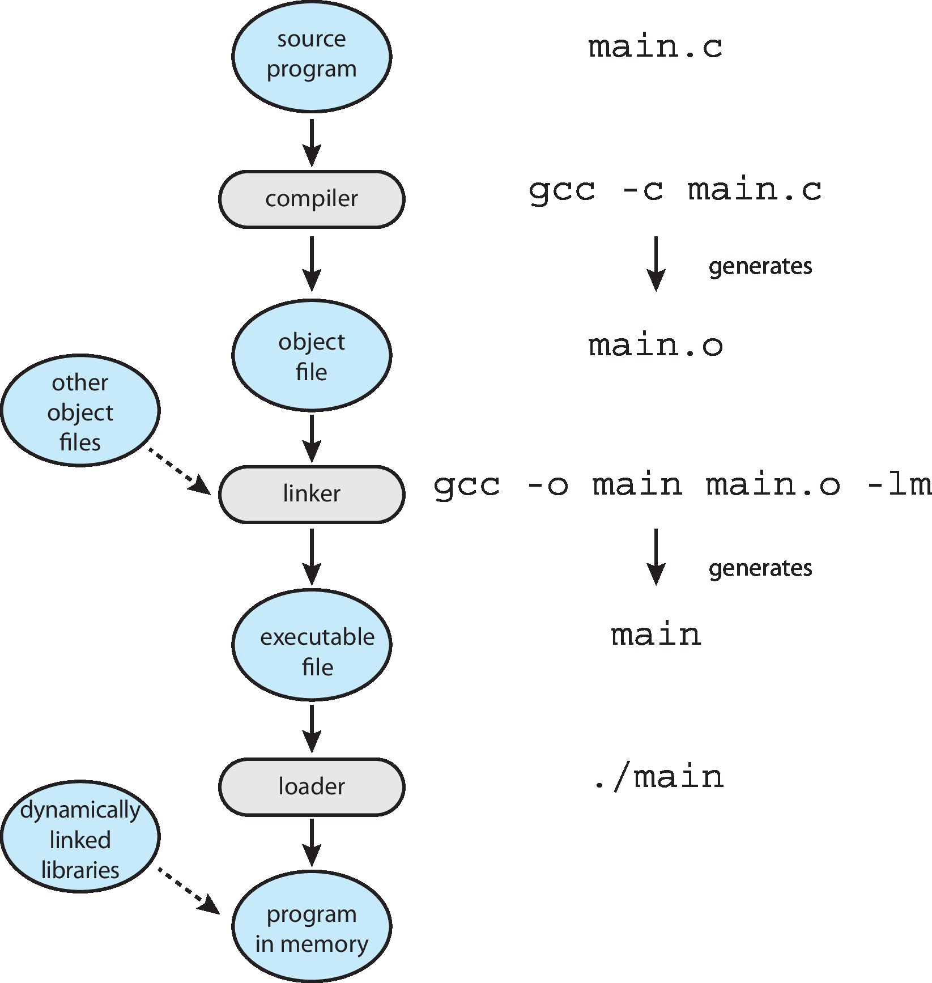
The Role of the Linker and Loader

Slide 40
Why Applications are OS specific?
Apps compiled on one system usually not executable on other operating systems
Each operating system provides its own unique system calls (own file format etc.)
Apps can be multi-operating system
  Written in interpreted language like Python, Ruby, and interpreter available on multiple operating systems
  App written in language that includes a VM containing the running app (like Java)
  Use standard language (like C), compile separately on each operating system to run on each
Application Binary Interface (ABI) is architecture equivalent of API, defines how different components of binary code can interface for a given operating system on a given architecture, CPU, etc.

